Slide 1
Building R-packages – basics
Raphael Hartmann
raphael.hartmann@staff.uni-marburg.de

Slide 2
Motivation
Building R-packages

Slide 3
Goal
Learn how to build/develop an R-package
Learn useful functions and workflows to improve efficiency
Learn goes and no-goes

Slide 4
Reasons
Share code with others
Make your functions and datasets easily accessible
It saves yourself time when reusing old functions of yours
You can also build a package to make reproducible data analysis (Marwick et al., 2018)

Slide 5
Setup
Building R-packages

Slide 6
Notes
Code syntax:
R code (and C/C++ code)
Terminal/shell code (bash) in RStudio terminal

Slide 7

Packages needed in R
You need to install devtools in R/Rstudio
install.packages("devtools")
Run the following line of code in RStudio to make sure you have everything set:
Devtools::has_devel()

Slide 8
Windows Setup
Building R-packages

Slide 9
Programs you need
MikTeX (LaTeX):
https://miktex.org/download
Download and install like all other programs
Open MikTeX and search for updates and install them
https://fonts.google.com/specimen/Inconsolata#standard-styles
Download and extract ZIP content
Go to „Start > Settings > Personalization > Fonts“
Drag and drop „Inconsolata-VariableFont_wdth,wght.ttf“ in the „drag-and-drop“ field

Slide 10
Programs you need
Depending on your R version you need:
Rtools4.0 (for R version 4.0.0 to 4.1.3):
https://cran.r-project.org/bin/windows/Rtools/rtools40.html
Download and install as usual
Rtools4.2 (for R version >= 4.2.0):
https://cran.r-project.org/bin/windows/Rtools/rtools42/rtools.html
Download and install as usual

Slide 11
macOS Setup
Building R-packages

Slide 12
Programs you need
You only need Xcode command line tools:
Install the current release of full Xcode: https://apps.apple.com/ca/app/xcode/id497799835?mt=12

Slide 13
Main Literature
Building R-packages

Slide 14

Most important literature
Writing R extensions (WRE) manual:
Main source for writing R-packages → the standard
html: https://cran.r-project.org/doc/manuals/R-exts.html
pdf: https://cran.r-project.org/doc/manuals/R-exts.pdf
Whenever in doubt look it up in WRE!

Slide 15
Additional literature
R-packages:
Book of Hadley Wickham and Jenny Bryan, open available at https://r-pkgs.org/
Who did what?
Paper about the roles of people who contributed to the package
pdf: https://epub.wu.ac.at/6395/1/RJ-2012-009.pdf
All about R:
https://cran.r-project.org/ → Manuals (bottom left)

Slide 16
Additional literature
R-package building in Windows:
https://cran.r-project.org/bin/windows/base/howto-R-4.2.html

Slide 17
Structure of R-packages
Building R-packages

Slide 18
Learning objective
What is the structure of an R-package?
Which files and directories are needed and which are optional?
How can you automatically generate a package skeleton?
What are the stages of an R-package?

Slide 19



Package – skeleton
mandatory files/directories
optional files/directories
pkgname/
man/
R/
data/
demo/
po/
src/
tests/
tools/
…
…
vignettes/
DESCRIPTION
NAMESPACE
INDEX
configure
cleanup
LICENSE or LICENCE
NEWS

Slide 20
Package – restrictions
None of the subfolders (data, demo, etc.) should be empty
If subfolder not used → remove it / don‘t generate it
Do not use the following symbols in file names:
‘"’, ‘*’, ‘:’, ‘/’, ‘<’, ‘>’, ‘?’, ‘\’, and ‘|’ as well as
ASCII control characters
There are other restrictions in https://cran.r-project.org/doc/ manuals/r-release/R-exts.html#Package-structure

Slide 21
Package name
There are also some restrictions for package names:
You can only use letters, numbers, and periods, but
it must start with a letter and
it must not end with a period
Suggestions:
Do not use periods since they might confuse people (the package name might look like a file with a special file extension)
You might want to use available::available(name, browse = TRUE) to check whether your package name is already in use

Slide 22
Package – make skeleton
A skeleton with the most important files and folders can be created by
package.skeleton(name = "anRpackage", list, environment = .GlobalEnv, path = ".", force = FALSE, code_files = character(), encoding = "unknown")
Downside: you need at least one R-object for the argument list.

Slide 23

Package – make skeleton
An easier way to do it is by using the usethis package (part of devtools)
usethis::create_package(path, fields = list(), rstudio = rstudioapi::isAvailable(), roxygen = TRUE, check_name = TRUE, open = rlang::is_interactive())

Slide 24

Short exercise
2
Build the skeleton for your first R-package
Set your working directory where you want your package-folder
Use the usethis::create_package() function
Use an arbitrary name like "mypkg" in the path argument
Set rstudio = TRUE, roxygen = TRUE, and open = TRUE
Note: If you do not wish to generate an R-project file set rstudio = FALSE and if you do not wish to open a new RStudio window set open = FALSE.

Slide 25
Alternatives for building a package skeleton
In Rstudio create a new Project
„File > New Project… > New Directory > R Package“
Fill in the form:
„Package name:“
„Create project as subdirectory of:“
Press „Create Project“
Yet another alternative is devtools::create()

Slide 26
The five states of an R-package
Source package
Bundled package
Binary package
Installed package
In-Memory package

Slide 27
The five states of an R-package
Source:
What we have so far: a folder with subdirectories and some files
Bundled:
A compressed single file with the content of the package folder with some exceptions:
Vignettes are already compiled to HTML and PDF
Some temporary files will be missing
Any files listed in .Rbuildignore (e.g., your Rproj-file; see later)
This state is needed when you want to submit to CRAN

Slide 28
The five states of an R-package
Binary:
Binary packages include, as the name suggests, binary code. This is especially intresting if you have C/C++ code in your package that needs to be compiled for each operating system separately.
Installed:
A binary package that is decompressed into a package library.

Slide 29
The five states of an R-package
In-Memory:
The command pkg::fnc() loads the package temporarily
The commands library() and require() load the installed package and attach it to the search path
For package building neither library() nor require() are helpful
Never use library() or require() in your package!

Slide 30
DESCRIPTION File
Building R-packages

Slide 31
Learning objective
What is the content of the DESCRIPTION file?
What of it is needed and what is optional/conditional?

Slide 32
Prototype by WRE manual
Package: pkgname
Version: 0.5-1
Date: 2015-01-01
Title: My First Collection of Functions
Authors@R: c(person("Joe", "Developer", role = c("aut", "cre"),
email = "Joe.Developer@some.domain.net"),
person("Pat", "Developer", role = "aut"),
person("A.", "User", role = "ctb",
email = "A.User@whereever.net"))
Author: Joe Developer [aut, cre],
Pat Developer [aut],
A. User [ctb]
Maintainer: Joe Developer <Joe.Developer@some.domain.net>
Depends: R (>= 3.1.0), nlme
Suggests: MASS
Description: A (one paragraph) description of what
the package does and why it may be useful.
License: GPL (>= 2)
URL: https://www.r-project.org, http://www.another.url
BugReports: https://pkgname.bugtracker.url
mandatory fields
„optional“ fields

Slide 33
Mandatory fields
Package: just write your desired package name
Only restriction: package name not already used in CRAN repository
Version: there are many conventions
Best practice: X.Y-Z
Also common: X.Y.Z
Z: minor changes/updates (patches); Y: larger changes; X: changes that affec the user (i.e., previous code not working anymore)
Special: 0.01 or 0.01.0 → 0.1-0

Slide 34
Mandatory fields
Date: usually filled in by R-package roxygen2 (see later), but at least by CRAN if you submit it there.
Title: short description for your R-package (see other packages for inspiration)

Slide 35
Mandatory fields
Author@R: this replaces the Author and Maintainer fields:
Concatenate (c) of person objects with names and role:
person(given = NULL, family = NULL, middle = NULL, email = NULL, role = NULL, comment = NULL, first = NULL, last = NULL)
Roles:
"aut" (author; contributet much to the package and should be cited)
"cre" (creator; package maintainer)
"ctb" (contributor; gave code but does not need to be cited)
"cph" (copyright holder; legal name for an institution or corporate body)
Each person can have multiple roles
Notes:
Mention the paper „Who did what“

Slide 36
Mandatory fields
Description: comprehensive description of what the package does.
Only one paragraph!
Do not start with the package name, „this package“, or similar
Use double quotes (") for quotations (including titles of books and articles)
Use single quotes (') for non-English usage, including names of other packages and external software
Use angle brackets for DOI and URL
E.g., Klauer and Kellen (2018, <doi:10.1016/j.jmp.2017.12.003>)
Here, the package name should be explained if necessary

Slide 37
Mandatory fields
Licence or License: typically something like GPL-2, GPL-3 or GPL (>= 2) and many others
When in doubt check other similar packages
Be careful when using proprietary libraries (in R, C/C++, etc.)
Some universities have their own licence like the MIT: MIT
Check https://cran.r-project.org/doc/manuals/R-exts.html#Licensing for more details
Notes:
Mention NAG in rtmpt

Slide 38
Short exercise
5
Fill in all needed fields of your DESCRIPTION file

Slide 39
Optional fields
Depends: If your package depends on a certain R version, e.g., version 4.2.0 or higher, write R (>=4.2.0). Only in rare cases it is necessary to name another R-package here. This will add the named package also to the search path if the user loads and attaches your package
Example where it is needed: lmerTest depends on lme4.
Imports: This is where you list almost all packages whose functions and data sets you use in your main code. Exceptions are on the next slide.

Slide 40
Optional fields
Suggests: Here you list packages that you only need for vignettes, examples or tests, but are not essential for the functions of your package to work.

Slide 41
Optional fields
URL: list of URLs separated by commas or whitespace:
Homepage of author
Page with additional material/information
BugReports: single URL to where bug reports should be submitted:
Will send the bug report to this URL instead of e-mailaddress of maintainer
Notes:
For bug report show „CRAN Rcpp“

Slide 42
Optional fields
LazyData: logical (true or false) field controls whether the R datasets use lazy-loading (i.e., if false the user needs to load your data with data(mydata) and if true the user can access it by typing mydata)
VignetteBuilder: names (in a comma-separated list) packages that provide an engine for building vignettes: e.g.: knitr
NeedsCompilation: write yes if you have C++ code that needs to be compiled. Otherwise remove the field.

Slide 43
NAMESPACE File
Building R-packages

Slide 44
Learning objective
What information is written in the NAMESPACE file?
How can this be automated?

Slide 45
NAMESPACE elements
Your package might include functions of other packages. These packages with the used functions are listed here as follows:
importFrom("lme4", lmer)
Your package includes functions that should be available for the users. These functions are listed here as follows:
export(fnc)

Slide 46
NAMESPACE elements
There are some special methods and functionality that needs to be listed here as well:
S3method(print, fnc_output_class)
useDynLib("pkg", .registration=TRUE)

Slide 47
The good news
All this can be handled by the package roxygen2 when making the documentation (see next topic)
Note: you can do it yourself without roxygen2 but this is tedious

Slide 48
Help Files / Documentation
Building R-packages

Slide 49
Motivation
Documentation is needed for
Functions which users of the package can use
Data which users might use
Package-overview
Documentation helps you and the user:
Whenever you get back to your functions after some time it helps to have documentation
The user, of course, does not know what your functions do

Slide 50
Learning objective
How does the roxygen2 syntax work?
How can you write documentation for functions, data, and the package-overview?

Slide 51

Documentation with roxygen2
The roxygen2 package allows to write documentation directly within your R script (within the /R subfolder) where your functions are defined
It is installed automatically when installing devtools
Every line of documentation starts with #' and is structured by certain tags with an @ in front of it (see next slide)

Slide 52
Prototyp of an R script describing a function
#' Elementwise Square
#'
#' \code{fnc} returns square of each element of a numeric vector.
#'
#' @param x A numeric vector (or scalar).
#' @return The output is a vector with the same length as \code{x}.
#' @examples
#' fnc(c(1,2,4))
#' \dontrun{
#' fnc("a")
#' }
#' @export
fnc <- function(x) {x^2}

Slide 53
Tags in roxygen2
The most important tags are:
@title: very short description (< 65 characters). Use capitalization and no period at the end. Does not have to be written out (see previous slide)
@description: a paragraph (a few lines) describing what the function does. If this tag is not provided, the title tag is used as description. Does not have to be written out; The second separated line is taken as description (see previous slide)

Slide 54
Tags in roxygen2
The most important tags for functions are:
@param: each function argument should have its own parameter tag. After @param the argument name must be provided, then a short description of the argument
@return: a description of what the function returns, e.g., a (named) list, a data frame, vector, or scalar.
@export: this tells roxygen2 that the function needs to be exported (i.e., it should be available for the user, which is important for the NAMESPACE file)

Slide 55
Tags in roxygen2
The most important tags for functions are:
@examples: here you make a line break and then wirte code that can (potentially) be executed. There are four types of code here:
x <- runif(10) Plain code which is shown in the help file and run in example() and R CMD check
\dontshow{log(x)} Code which is run by example() and R CMD check but not shown in the helpfile (i.e., included just for testing)
\dontrun{plot(x)} Code which is shown but not run
\donttest{exp(x)} Code that is not run by R CMD check but run by example() and shown in help file

Slide 56

Workflow
Repeat the following until you are satisfied:
Add/change roxygen comments to/in your R script
Compilation: do either of these
run devtools::document() (which calls roxygen2::roxygenize())
press Ctrl/Cmd+Shift+D
Preview documentation with the ?-symbol (e.g., ?fnc)

Slide 57
Short exercise
5
Write a short custom R function in an R script (fnc1.R)
Write the roxygen comments for your function
Use the Workflow described in the previous slide. Change the compilation method each time you make changes:
Run command (devtools::document())
Press short-cut (Ctrl/Cmd+Shift+D)

Slide 58
Additional useful commands in brief
#' @importFrom another_pkgname fnc1 fnc2
#' @references
#' Klauer, K. C. (2010). Hierarchical multinomial processing tree
#' models: A latent-trait approach. \emph{Psychometrika, 75(1)}, 70-98.
#' doi:\doi{10.1007/s11336-004-1188-3}
#' @author Raphael Hartmann
#' @useDynLib "pkgname", .registration=TRUE
#' @seealso \code{\link{functionname}}
#' @section Arbitrary sectiontitle:
#' Write what you need in you custom section.

Slide 59
Tags in roxygen2
Additional (important) tags for functions are:
@importFrom: If you use functions from another package (e.g., stats) you need to name them here. This tells roxygen2 that the function(s) of the package another_pkgname should be imported, which is important for the NAMESPACE file)
@references: Name all papers which your package builds on.
@authors: Name yourself (and others who have wrote on the function)

Slide 60
Tags in roxygen2
Additional (important) tags for functions are:
@useDynLib: If your function uses C/C++ code
@seealso: Here you can make references to other functions (of yours)
@section: Write a custom section in your help file. Typically, you won‘t need this.

Slide 61
Short exercise
2
Change your function so that you need a function of another package (e.g., runif() of the stats package) → Adapt DESCRIPTION file
Change the documentation accordingly, if needed.
Let roxygen2 know that you want to import the corresponding function from a package by providing the tag @importFrom
Additionally you can add your name as author and add a reference to some arbitrary paper by using @author and @references, respectively

Slide 62
Data documentation
Data does not exist as R code!
Therefore we need to generate an R script, in which we describe the dataset as detailed as possible (see next slide).

Slide 63
Prototype of an R script for data documentation
#' Prices of 50,000 round cut diamonds.
#'
#' A dataset containing the prices and other attributes of almost 54,000
#' diamonds.
#'
#' @format A data frame with 53940 rows and 10 variables:
#' \describe{
#' \item{price}{price, in US dollars}
#' \item{carat}{weight of the diamond, in carats}
#' ...
#' }
#' @source \url{http://www.diamondse.info/}
"diamonds"
Name of R object (data.frame), not of .RData file
Notes:
Do not export this.

Slide 64
Tags in roxygen2
The most important tags for data are:
@format: here you describe the structure of your dataset:
You can use \describe{} and \item{variable}{variable description} to make the description look nicer
@usage: if you use LazyData: true in the DESCRIPTION file then this is not needed, but if not you must write data(mydat) here
@source: typically just an \url{https://...} if you did not simulate the data (you can, of course, write simulated or Simulation here)

Slide 65
Tags in roxygen2
The most important tags for data are:
@examples: here you make a line break and then wirte code that can (potentially) be executed. This is basically the same as for functions.

Slide 66
Package-overview documentation
There is also no R code for the package-overview!
Therefore we need to generate an R script, in which we describe the package-overview (see next slide).

Slide 67
Prototype of package-overview documentation
#' pkgname: A toy package
#'
#' The package pkgname provides one function and a dataset:
#' fnc, a function to calculate the square and
#' df, a data frame with random values.
#'
#' @section Functions:
#' The functions ...
#' @section Datasets:
#' The datasets ...
#' @docType package
#' @name pkgname
NULL

Slide 68
Formatting text
For ways to format and mark text within the documentation, see https://cran.r-project.org/doc/manuals/R-exts.html#Marking-text or https://r-pkgs.org/man.html#text-formatting

Slide 69
Short exercise
5
Generate a new R script with documentation for your package-overview
Generate some random data frame (e.g., mydat) in the console and save it as mydata1.RData in the data/ subfolder. Generate a new R script with documentation for your data.
Inspect the help pages for both
Notes:
Warning! Should appear

Slide 70
Alternative to roxygen2
You can write your documentation directly in the man/ subdirectory
WRE gives a guide on how to do it: https://cran.r-project.org/doc/manuals/R-exts.html#Writing-R-documentation-files
This way you have to write an .Rd file for each function and dataset

Slide 71
Terminal Commands and Alternatives
Building R-packages

Slide 72
Why learning the terminal commands
WRE will often talk in terms of terminal commands and not R commands that devtool and co. use.
Whenever you are unsure about a topic and need to consult WRE, you need to know at least the basics.
Therefore it helps to know a little bit about the bash (terminal) syntax.

Slide 73
Learning objective
What are the most important terminal commands?
What are the alternatives for those commands?

Slide 74


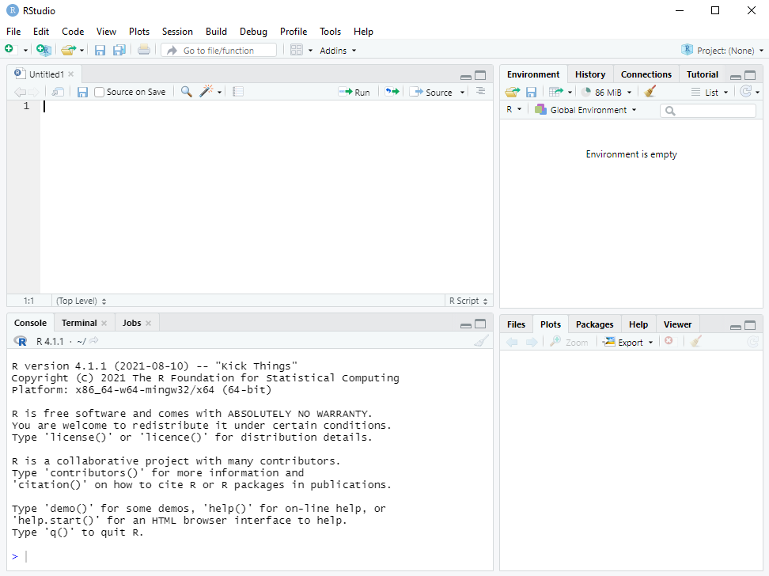
RStudio terminal
Notes:
Linux and Mac users can use the native terminal

Slide 75
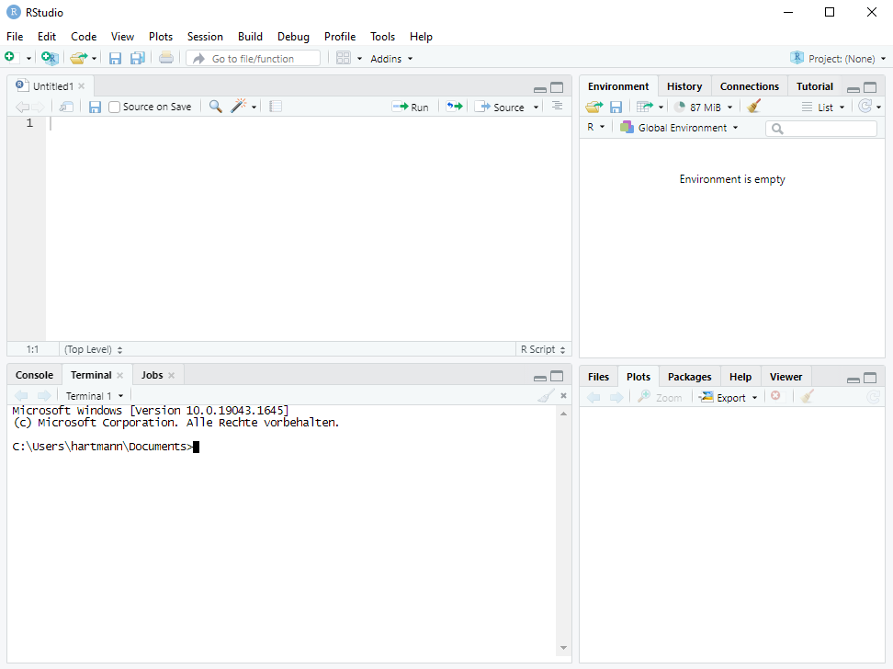
RStudio terminal

Slide 76
Navigation in the (RStudio) terminal (bash)
You can change your current directory with the command cd and list the content of the current directory with ls.
Change to the subdirectory R/:
cd R/
list the content of R/:
ls .
Change to the parent folder (the superfolder) of R/ (i.e., pkgname/):
cd ..
Change to the parent folder of the package (i.e., where pkgname/ lies):
cd ..
Notes:
Show participants the Rstudio options and how to use the terminal

Slide 77
Building and installing the basic package
In the terminal you can generate the tarball (tar.gz file):
R CMD build pkgname
Check the basic package with (but replace 0.0-1 with the current version)
R CMD check pkgname_0.0-1.tar.gz
Install the basic package with (but replace 0.0-1 with the current version)
R CMD INSTALL pkgname_0.0-1.tar.gz

Slide 78

CRAN check
If you want to submit your package to CRAN you need to run the following command and there must not be an Error or Warning (Notes are ok‘ish):
R CMD check --as-cran pkgname_0.0-1.tar.gz
See https://r-pkgs.org/r-cmd-check.html for common errors

Slide 79
Short exercise
5
Do the following in your RStudio terminal:
Generate the package tarball
Check the package tarball (for CRAN-feasibility)
Install the package
Note: if there are some errors or warnings in either of the steps, copy them (text from a terminal can be copied by right-click and „copy“) somewhere and try to solve them → we will discuss them!
Notes:
Warning! Should appear
Problem mit latex: https://tex.stackexchange.com/questions/125274/error-font-ts1-zi4r-at-540-not-found

Slide 80
Build, check, and install using R functions
Use devtools::build() to build a bundled package
You can also build a binary package by using binary = TRUE
Use devtools::check() to build and check a bundled package
Per default this checks for CRAN-feasibility
Use devtools::install() to build a bundled package and install it

Slide 81
.Rbuildignore
Whenever you have additional notes and data that does not need to be in your package and is just for you .Rbuildignore helps you
Opt-out list: everything that is listed in .Rbuildignore will not be part of the bundled package. It might look like:
^.*\.Rproj$
^\.Rproj\.user$
README\.Rmd$
...

Slide 82
Clean-up for building a bundled package
But how to handle .Rbuildignore?
An easy way to exclude files and subdirectories is:
usethis::use_build_ignore(files = c("name"))
Where "name" ist the name of a file or subdirectory
Note (to Linux users): Do not use a period and a slash in front of the name(s) to indicate that you mean the subdirectory in the current location. The command takes the name(s) literally!
Note to Windows users: Do not use back-slashes in the path to a file in a subdirectory!

Slide 83
Short exercise
2
Generate an arbitrary subdirectory in your package directory and some random file like „random_file.txt“ in this new directory
Use devtools::build() to build your package and check the structure of the bundled package
Use usethis::use_build_ignore() with the file path and check again the structure of the bundled package
Notes:
Warning! Should appear

Slide 84
General Workflow
Building R-packages

Slide 85
Workflow
Repeat the following until you are satisfied:
Edit an R file (e.g., a function within an R file)
If you have made any changes that impact help files or NAMESPACE, then use devtools::document()
Load the source package into memory (attach it to the search path; see next slide)
Explore the code in the console
Check the package

Slide 86
Loading a source package into memory
Usually, you do not install your package and test it. You only load and attach its functions etc. to the search path:
devtools::load_all()
You can have the same effect by clicking
„Build > Load All“
… or by pressing
Ctrl/Cmd+Shift+L

Slide 87
Short exercise
2
Empty your global environment
Load your function/s with devtools::load_all() and execute the one of your functions with some arbitrary values
Is/are your package function/s in the global environment?
Notes:
Warning! Should appear

Slide 88
Summary
Building R-packages

Slide 89
The most important commands
Goal | R comand
Check package name availability | available::available(name)
Create package skeleton | usethis::create_package(path)
Load everything from your package | devtools::load_all()
Build package documentation via roxygen2 | devtools::document() (→ ?/help())
Exclusion list for bundled package | usethis::use_build_ignore(files)
Check package for (CRAN) feasibility | devtools::check()
Build final bundled package (for CRAN) | devtools::build()
Install package | devtools::install()
Notes:
Some of these steps can be optimized. For example testing the functions in your package.

Slide 90
A possible R-package
Building R-packages

Slide 91
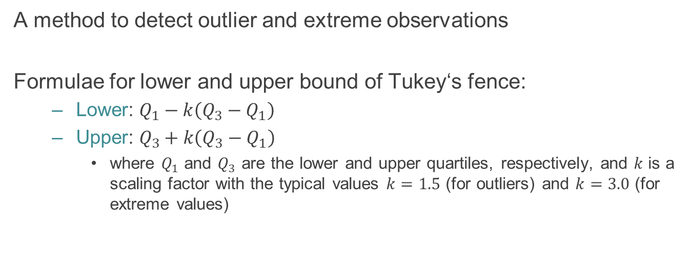
Tukey‘s fence
A method to detect outlier and extreme observations
Formulae for lower and upper bound of Tukey‘s fence:
Lower: $Q_{1}−k\left(Q_{3}−Q_{1}\right)$
Upper: $Q_{3}+k\left(Q_{3}−Q_{1}\right)$
where $Q_{1}$ and $Q_{3}$ are the lower and upper quartiles, respectively, and $k$ is a scaling factor with the typical values $k=1.5$ (for outliers) and $k=3.0$ (for extreme values)

Slide 92
Exercise
30
Build the basic R-package for Tukey‘s fence using what we have learned so far, either
Together (you tell me what to do) or
in small groups (and I help)
Alternative Exercise: you decide your own small project

Slide 93
Other topics to discuss
(meta)data
Git and GitHub
Testing
Vignettes
C/C++ integration

Slide 94
Building R-packages – (meta)data
Raphael Hartmann
raphael.hartmann@staff.uni-marburg.de

Slide 95
Data in packages
Building R-packages

Slide 96
Learning objective
What type of data is there?
Where to put your data in the package structure?

Slide 97
Options
There are multiple options for including data in your package depending on what you need it for. Put data in …
data/ if the users should have access to the binary data. By using LazyData: true in DESCRIPTION access is even easier
R/sysdata.rda if you have (many) R objects that need to be available for your functions to work but should not be accessible for users
inst/extdata/ if you want to store raw data. You can acces it witth system.file("extdata", "mydata1.txt", package = "pkgname").
Notes:
These are all fixed data.
If you need data on the run, you can use tempdir() and tempfile() to temporary store files on the users PC

Slide 98
Exported data
Location: data/
Type of data: .rda (or .Rdata) created with
the save() function or
the usethis::use_data(df1, df2, …) where df1 and df2 are some data.frames. This also creates data/ if it does not already exist
Accessible to users: yes → data(dataname)
Options: LazyData: true
easier access (just write name of data.frame) and
uses only memory when the dataset is explicitly loaded

Slide 99
Exported data
Peculiarity :
Data sets must be documented
Data sets are already pre-processed
Add on:
Use usethis::use_data_raw() to store the raw data in data_raw/
You might also save the scripts to pre-process them in data_raw/
Typically this folder and scripts should be excluded from the bundled package by writing entries in .Rbuildignore

Slide 100
Internal data
Location: R/sysdata.rda
Type of data: .rda (or .Rdata)
created with the usethis::use_data() function and the internal = TRUE argument
Accessible to users: no
Access in your package: just write the name of the data.frame

Slide 101
Internal data
Peculiarity:
No documentation needed
Data sets are already pre-processed
Add on:
Use usethis::use_data_raw() to store the raw data in data_raw/
You might also save the scripts to pre-process them in data_raw/
Typically this folder and scripts should be excluded from the bundled package by writing entries in .Rbuildignore

Slide 102
Raw data
Location: inst/extdata/
Type of data: all types (.csv, .txt, ...)
Accessible to users: yes
Usable with system.file("extdata", "dataname.csv", package = "pkgname")
This type of data is more for examples, tests, or vignettes. They serve to demonstrate how to use raw data with your package

Slide 103
Data for vignettes and tests
Vignettes: either use data/ or inst/extdata/ to store binary data or raw data, respectively
Tests: use tests/ to store data that is needed for tests, but keep them as small as possible

Slide 104
Large data
CRAN will not allow data that is too large (see CRAN check; files larger 1 MB)
If you have this problem then https://r-pkgs.org/data.html might help you

Slide 105
CITATION
Building R-packages

Slide 106
Learning objective
How to customize the citation of your package?
If you have a paper about the development of your R-package… How can you tell others to cite the paper instead?

Slide 107
Citing R-packages
To get the reference of a package just use
citation("pkgname")
If you leafe the argument empty you will get the reference for the R-package base.
To customize the reference of your R-package create a citation file in the inst/ folder: inst/CITATION

Slide 108
inst/CITATION
citHeader("To cite rtmpt in publications use:")
note <- sprintf("R package version %s", meta$Version)
citEntry(entry = "Article",
title = "{rtmpt}: {An R} package for fitting response-time extended multinomial processing tree models",
author = personList(as.person("Raphael Hartmann"),
as.person("Lea Johannsen"),
as.person("Karl Christoph Klauer")),
journal = "Behavior Research Methods",
year = "2020",
volume = "52",
number = "3",
pages = "1313--1338",
doi = "10.3758/s13428-019-01318-x",
note = note,
textVersion = paste("Hartmann, R., Johannsen, L., & Klauer, K. C. (2020).",
"rtmpt: An R package for fitting response-time extended multinomial processing tree models.",
"Behavior Research Methods, 52(3), 1313-1338.", "doi: 10.3758/s13428-019-01318-x")
)
Notes:
BIBTEX entry

Slide 109
Building R-packages – Git and GitHub
Raphael Hartmann
raphael.hartmann@staff.uni-marburg.de

Slide 110
Learning objective
What are advantages of Git and GitHub?
How does GitHub improve your collaboration?

Slide 111


Git and GitHub
Git: Version control system:
Track changes
Work with others (on the same files)
GitHub: Website for hosting your code
Share your projects/code with others
R-packages on it can be installed with devtools::install_github()
Make easy website for your package (and other things) using Markdown
Others can suggest changes to your code

Slide 112
Integration in RStudio
You can use Git in an RStudio project
Use the most basic features of Git by clicking buttons
This works in 90% of the cases just fine
Nevertheless: You need to learn
The basics of Git and
The basics of using a Terminal/Shell/command-line

Slide 113
Terminal basics repetition
We already looked at some terminal commands:
list the content of your current directory you are in:
ls
list the content of another directory:
ls /path/to/another/directory
change the current directory:
cd /path/to/new/directory
change the current directory in relation to your current directory:
cd ./path/to/subdirectory

Slide 114
Setup
Install Git and create a GitHub account:
Download and install Git: https://git-scm.com/download/
In RStudio Terminal or GitBash write:
git config --global user.name "YOUR FULL NAME"
git config --global user.email "YOUR EMAIL ADDRESS“
git config --global --list
Create an account on GitHub with same emailaddress: https://github.com
Download and install an SVN client: https://subversion.apache.org/packages.html#windows (I use SlikSVN)

Slide 115
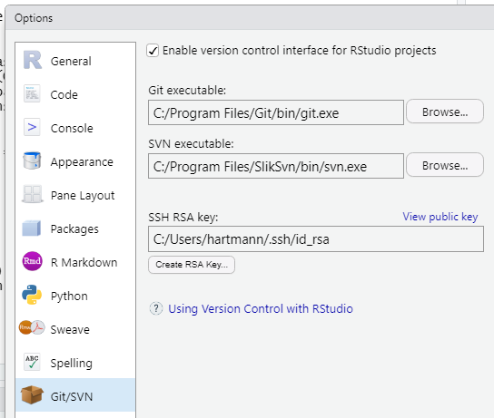
Setup
Install Git and create a GitHub account:
Restart RStudio
Make an SSH key: Go to „Tools > Global Options… > Git/SVN“ and click „Create RSA Key“ → Enter a password you can remember
Copy the public key by copying the content of „View public key“
Go to https://github.com/settings/ssh and give it your SSH publik key
Click „New SSH key“, give it a name, and paste the publik key and create.

Slide 116
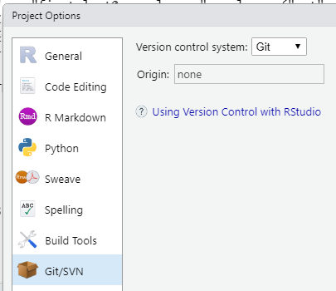
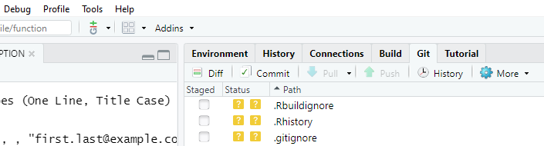
Local Git repository
Creating a new local repository:
Go to „Tools > Project Options… > Git/SVN“ and change „Version control system“ from „(None)“ to „Git“
Change to the RStudio Terminal and write git init
You can see two new components:
Git pane:
shows the most important Git commands for your project
Git-dropdown:
Includes Git & GitHub commands for the current file
Notes:
Git-Dropdown (left): includes Git and GitHub commands for the current file
Git pane (right next to environment): shows the most important Git commands for your project

Slide 117
Local Git repository
First step:
usethis::use_git()
This will:
Create the file .gitignore
Add the most important entries to .gitignore
Initialize Git

Slide 118
Short exercise
5
Install Git, an SVN client and create a GitHub account, if you do not already have one; see 3 slides back)
Create an SSH key in RStudio (if you do not have one already) and tell it GitHub (see 2 slides back)
Create a local Git repository (see 1 slide back) for your R-package
Notes:
Warning! Should appear

Slide 119
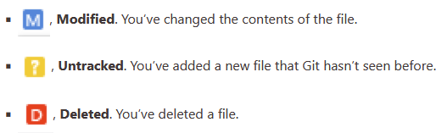
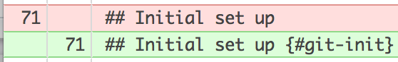
Track changes
Use the Git pane for an overview about the changes in your project:
Use the Diff function for specific changes in one of your files:
Colors indicate changes: gree = added code; red = removed code
Notes:
Color-blind people can use the columns on the left side: left = removed code; right = added code

Slide 120
Track changes – Terminal
Terminal command for an overview of your project changes:
git status
Terminal command for specific changes in one of your files
git diff /path/to/file

Slide 121
Record changes
Use the Commit function to save a snapshot of your project:
Components of a commit:
Unique identifier (SHA; secure hash algorithm)
List of changes: added, modified, deleted
Commit message
Parent commit (the one before that)
Author

Slide 122
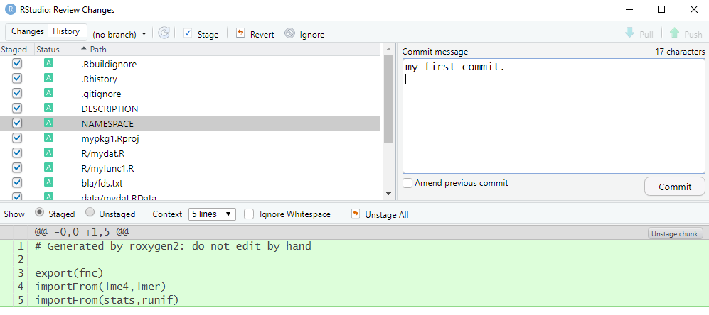
Record changes
Steps:
State which changes should be in the next commit → stage files
Make the commit with message → commit the staged files

Slide 123
Record changes – Terminal
Stage a file:
git add filename
Commit changes:
git commit –m "my commit message"

Slide 124
Commit – best practice
An optimal commit should be
minimal: only include changes related to a single problem.
complete: the problem should be solved with the commit. Add a unit test to confirm
An optimal commit message should be
concise and evocative: it should be clear at a glance, what the commit was about, but also detailed enough to remember what you did
explanatory: it should provide reasons for the changes
Notes:
At least the future-you will profit from your effort
concise=prägnant
evocative=herausschreiend

Slide 125
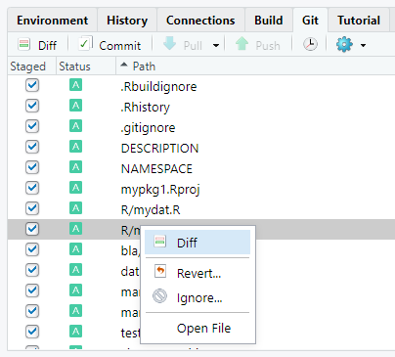
Ignoring files: .gitignore
Files that should never be in a commit should be named in the file .gitignore.
In the git pane you can right-click a file and then click Ignore…
This will add the name to .gitignore
Use wildcards like *.png to let Git know that all files with this extension should be ignored

Slide 126
Workflow
Repeat the following each time you have made (major) changes:
Save your changes
(Check whether .gitignore is complete)
Open the commit window (Ctrl/Cmd+Alt+M)
Select the files that should be staged (or press Ctrl/Cmd+A to select all)
Clickthe Stage button
Write a commit message
Click „Commit“

Slide 127
Go back to your last commit
Two options for undoing changes:
Undo all changes in a file: in the Git pane right-click a file an select Revert…
Undo selected changes in the code: In the Diff-Window mark the line(s) in the code and select Discard line / Discard chunk
Notes:
There are ways to go way back to a past commit, but we will not go into that

Slide 128
Short exercise
5
Make sure .gitignore is set properly
Make some minor changes to your package and make new commit(s)
Play around with the diff-check function and the possibility to go back to your last commit
Use the Terminal to make commits
Notes:
Warning! Should appear

Slide 129
Connect your Project with GitHub (only once)
Connect your local project with a GitHub repository:
Create the repository in https://github.com/new by using the same name as your R-package and add the package title as the description of the repository. Hint: you will see a https and ssh link → copy the ssh link for the next step
Open the RStudio Terminal and type the following but use your ssh link:
git remote add origin git@github.com:<GitHub_user.name>/<pkgname>.git
git push –u origin master
If you forgot to copy your link, just fill in your GitHub user name and package name by replacing the content within <> and removing the symbols < and >

Slide 130

Updating your GitHub Repo (after each change)
Updating your GitHub Repository:
Modify your files
Example: Add the fields URL and BugReports to DESCRIPTION
URL: https://github.com/<GitHub_user.name>/<pkgname>
BugReports: https://github.com//<GitHub_user.name>/<pkgname>/issues
Save the changes and commit
Push your changes by clicking the Push button
Go to your GitHub Repository and check the changes
Note: Usually you run R CMD check before pushing and you push less often than commit

Slide 131
Short exercise
5
Make a GitHub repository and sync it with your local Git repository
Make a small change somewhere, commit and push it again and check the changes on GitHub
Notes:
Warning! Should appear

Slide 132
Push and Pull
Push: By pushing you update your GitHub repository.
This serves as a back-up and to share with others.
Pull: By pulling you update your local Git repository.
This is needed when you work with others who made changes to your package.

Slide 133
Pull
A pull does three things:
Downloades (fetches) the files from GitHub
Merges your local version with the one from GitHub
This can go wrong (see next slide)
Commits the changes

Slide 134
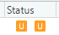
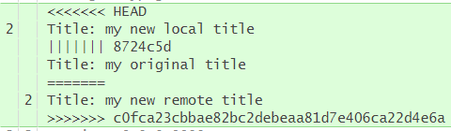
Merging problems
When your local changes and the ones that come from GitHub collide you will either get:
Merging error → Pull request fails → read error and debug
Merging conflict: Unresolved merging status → Git pane shows → local and remote commits have changes on the same line(s)
After local changes
Before changes
After remote changes

Slide 135
Merging problems
Options for merging conflicts:
Show only local and remote version (default):
git config --global merge.conflictstyle diff2
Show local, original, and remote version (see previous slide):
git config --global merge.conflictstyle diff3
Notes:
….
I will stop here with Git and GitHub since I am not an expert in working with others via GitHub. But these are the basics.

Slide 136
Building R-packages – Testing
Raphael Hartmann
raphael.hartmann@staff.uni-marburg.de

Slide 137
Motivation
You will probably forget what tests were necessary and which of these you already did
Writing code for testing will lead to
Fewer bugs
Better code structure
Easier restarts
Robust code

Slide 138
Learning objective
What tools to use for testing?
How to automate testing?
How to add testing to your workflow?

Slide 139

Package testthat 3rd edition
First step:
usethis::use_testthat(3)
This will:
Create the subfolder tests/testthat
Add testthat to Suggests in the DESCRIPTION file
Create the file tests/testthat.R, which is responsible for running all your tests when R CMD check is used.

Slide 140
Workflow
Repeat the following until you are satisfied:
Edit an R file (code or tests)
Test your package with devtools::test() (or press Ctrl/Cmd+Shift+T)

Slide 141
Running tests
Running devtools::test() will give you an output like:
Expectation : ...........
rv : ...
Variance : ....123.45.
where each dot represents a passed test and each number a failed test
For each failed test you will get more details:
1. Failure(@test-variance.R#22): Variance correct for discrete uniform rvs ----- VAR(dunif(0, 10)) not equal to var_dunif(0, 10) Mean relative difference: 3

Slide 142
Example of a test file
library(stringr)
context("String length")
test_that("str_length is number of characters", {
expect_equal(str_length("a"), 1)
expect_equal(str_length("ab"), 2)
expect_equal(str_length("abc"), 3)
})
test_that("str_length of factor is length of level", {
expect_equal(str_length(factor("a")), 1)
expect_equal(str_length(factor("ab")), 2)
expect_equal(str_length(factor("abc")), 3)
})

Slide 143
Test file structure
test_XYZ.R: A test file with tests that share the same context, where XYZ stand for some name you want to give. It typically consists of:
Multiple test_that(desc, code) calls: a bundle of tests that are related. They consist of:
desc: A description of what the tests should do. This description should finish the sentence „Test that …“
code: Multiple Expectations; the atom of testing. They always start with expect_ and end with equal(), error(), warning(), message(), etc. (e.g., expect_equal()). All these sub-tests should be closely related

Slide 144
Expectations
Most of the expect_ functions have two arguments
The actual result
The expected result
If the results do not match an error is thrown
The functions can be called interactively

Slide 145
Expectations
Equality:
Two types of equality:
equal (up to an error of 1.0e-7):
expect_equal(10, 10 + 1e-7) # no error
identical (exactly equal):
expect_identical(10, 10 + 1e-7) # error

Slide 146
Expectations
Matches:
Match a character expression against a regular expression:
Example:
expect_match("Testing is fun!", "Testing") # no error
i.e., is the expression „Testing“ included in „Testing is fun!“
The first argument can also be a vector of characters
you can specify whether the expression in the second argument must be in all elements of the vector by an additional argument all = TRUE
Example:
expect_match(c("bla", "bli"), "bla", all = TRUE) # error
Notes:
Internally grepl is used

Slide 147
Expectations
Output, Message, Warning, and Error
Four variations of matches
Difference to matches: You can answer two questions:
Does the output/message/warning/error contain a certain expression?
expect_warning(log(-1), "NaNs produced") # no error
Do you expect an output/message/warning/error?
expect_warning(log(1/0)) # error because log(1/0) = Inf <- no warning
But it is advised to be specific and only use the first type of question
Notes:
Four variations of expect_match

Slide 148
Expectations
Type, S3-class, S4-class:
Checks for inheritance:
expect_type(data.frame(a=c(1,2)), "list") # no error
expect_s3_class(data.frame(a=c(1,2)), "data.frame") # no error
expect_s4_class(data.frame(a=c(1,2)), "list") # error since no S4-object
i.e., is your object of the specified type ("list"), S3-class ("data.frame"), or S4-class

Slide 149
Expectations
True and False:
Checking whether an expression is true or false
expect_true(2 < 4) # no error
expect_false(2 < 4) # error
Typically only useful when other expectation functions cannot be used

Slide 150
More information on testthat
For more information see:
https://testthat.r-lib.org/articles/

Slide 151
Alternatives
Alternative packages are tinytest and RUnit
Advantage of tinytest and RUnit:
less dependencies than in testthat,
i.e., less Imports or Suggests in DESCRIPTION file of these packages compared to testthat
Disadvantage:
less comfort
i.e., there are more functions in testthat
Why do dependencies matter?: https://www.tinyverse.org/

Slide 152
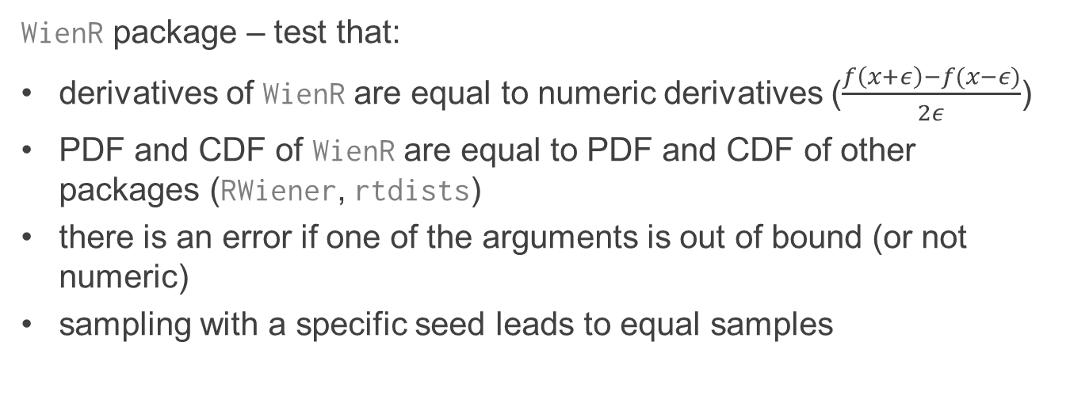
Exercise
10
WienR package – test that:
derivatives of WienR are equal to numeric derivatives ($\frac{f\left(x+ε\right)−f(x−ε)}{2ε}$)
PDF and CDF of WienR are equal to PDF and CDF of other packages (RWiener, rtdists)
there is an error if one of the arguments is out of bound (or not numeric)
sampling with a specific seed leads to equal samples

Slide 153
Building R-packages – Vignettes
Raphael Hartmann
raphael.hartmann@staff.uni-marburg.de

Slide 154
Learning objective
What is the purpose of a vignette?
What is a simple way to make a vignette?

Slide 155
Package vignettes
File types: any, but strongly recommended to use html or pdf
Location:
Source: vignettes/ (code that will generate the html or pdf file)
Output: inst/doc/ (the html or pdf files)
Default vignette engine: Sweave,
But this is tedious. There are better/simpler options, namely knitr and rmarkdown

Slide 156


Packages rmarkdown and knitr
First step:
usethis::use_vignette("my-vignette")
This will:
Create the subfolder vignettes/
Add knitr and rmarkdown to the field Suggests and also knitr to the field VignetteBuilder in DESCRIPTION
Create an rmarkdown template-file vignettes/my-vignette.Rmd

Slide 157
Workflow
Repeat the following until you are satisfied:
Edit an .Rmd file (code and text)
Knit your vignette by clicking the Knit-button (or press Ctrl/Cmd+Shift+K)
Inspect

Slide 158
Vignette template (yaml code)
---
title: "my-vignette"
output: rmarkdown::html_vignette
vignette: >
%\VignetteIndexEntry{my-vignette}
%\VignetteEngine{knitr::rmarkdown}
%\VignetteEncoding{UTF-8}
---
Notes:
yaml ain‘t markdown language

Slide 159
Fields title, author, date
Next to title you might add fields for author and date:
title: the title of the vignette
author: name(s) of author(s) of the vignette
date: either a specific date or write date: "`r Sys.Date()`" with quotes

Slide 160
Field output
The default is rmarkdown::html_vignette
This will create a html file for your vignette
Another option is: rmarkdown::pdf_document
This will create a pdf file for your vignette

Slide 161
Field vignette
Metadata needed for R:
The metadata looks like LaTeX commands
Most of the times you only want to change %\VignetteIndexEntry{}
The argument of this function is the name that will appear in the help pages of your package
The other two should not be changed if you use knitr and rmarkdown:
Vignette engine: %\VignetteEngine{knitr::rmarkdown}
Engoding: %\VignetteEncoding{UTF-8}

Slide 162
Vignette template (knitting options)
```{r, include = FALSE}
knitr::opts_chunk$set(
collapse = TRUE,
comment = "#>"
)
```
Notes:
R block for knitting options:
collapse: output of R commands are shown in the same R field. Otherwise there is an R field for the command and one for the output
Comment: how should the output be indicated. In this case by a leading # and > symbol

Slide 163
(R)Markdown
Markdown is a markup language that is
easy to use and
easy to read
Readability is the main goal of this documentation language

Slide 164
(R)Markdown
Section headers can be added by using the # Symbols:
Heading 1: # Title 1
Heading 2: ## Title 1.1
Heading 3: ### Title 1.1.1
Horizontal lines can be added by using three or more hyphens or asterisks:
Soft line: ---
Normal line: ***

Slide 165
(R)Markdown
Unordered lists can be added by using one * Symbol:
* unordered list item 1
* unordered list item 2
* nested list item by using four spaces
Ordered lists can be added by using 1. or a. for each list item:
1. ordered list item 1
a. nested ordered list item
1. ordered list item 2
Notes:
… and many more easy commands to do stuff → check the link or the R Package book

Slide 166
(R)Markdown
Non-highlighted code can be added by using ```:
```
# some code
```
Highlighted R code can be added by using ```{r}:
```{r}
# some code
```
Notes:
This also works with many more programming languages
… and many more easy commands to do stuff → check the link or the R Package book

Slide 167
Exercise
10
Create your first package vignette using usethis::use_vignette()
Use the basic features of Markdown to create a header and some code
Check https://r-pkgs.org/vignettes.html and discover the different options for writing code blocks using ``` with r or {r} and other options
Notes:
Warning! Should appear

Slide 168
Some common problems
If you need any additional packages only for your vignette
Add the package name to the Suggests field in DESCRIPTION
If you want to see the vignette in the help functions
Install your package
Make sure you wrote vignettes/ not vignette/
Make sure you have all metadata for your vignette set properly
Keep the file size in mind

Slide 169
More on using rmarkdown
Check the homepage of rmarkdown https://rmarkdown.rstudio.com/ for a thorough guide on how to use it

Slide 170
Building R-packages – C/C++ integration
Raphael Hartmann
raphael.hartmann@staff.uni-marburg.de

Slide 171
Learning objective
What are the benefits of C++?
What are the drawbacks?
How does the native way of C++ integration work?
Is there a simpler way of integrating C++ code in R?

Slide 172
Benefits and drawbacks
Benefits of using C++ in R: You can write code that is
more efficient
faster
Drawbacks of using C++ in R:
More error prone:
the C++ code you write mus be compatible with R → there are rules, especially when using C++ functions that produce console output (messages, errors, warnings).
C++ is a very complex language: e.g., debugging is a nightmare
Notes:
→ You need to know whether spending the time is worth while.

Slide 173
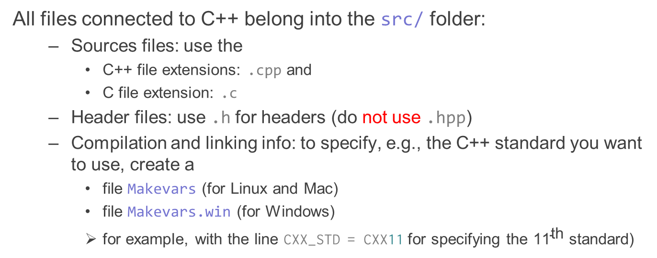
The basic structure
All files connected to C++ belong into the src/ folder:
Sources files: use the
C++ file extensions: .cpp and
C file extension: .c
Header files: use .h for headers (do not use .hpp)
Compilation and linking info: to specify, e.g., the C++ standard you want to use, create a
file Makevars (for Linux and Mac)
file Makevars.win (for Windows)
for example, with the line CXX_STD = CXX11 for specifying the ${\text{11}}^{\text{th}}$ standard)

Slide 174
The basic structure
All files connected to C++ belong into the src/ folder:
Typicall one C++ file with wrapping functions:
in R you cannot directly call a C++ function. You have to wrap it in a wrapping function that can communicate with R.
Depending on what way of C++ integration you use this file looks different.
We will see how this works in both cases
One C file naming the C++ wrapping functions to be called from within R:
typically this file is called <pkgname>_init.c
here you register the functions so that R can use them

Slide 175
A basic .cpp file example
3.14159265358979323846
// file circle.cpp
#include <R.h>
double C_PI = 3.14159265358979323846;
double power(double x, int i) {
double result = 1;
for (int ii = 0; ii < i; ii++) result = result * x;
return result;
}
// calculate circle area A = pi * r^2
double circlearea(double r) {
double A = C_PI*power(r, 2);
Rprintf("The area of the circle is\n:", A);
return A;
}
Nuissance function
Function we want in R

Slide 176
A .cpp file example – outsource code
3.14159265358979323846
// file circle.cpp
#include "tools.h" // for C_PI and power()
// calculate circle area A = pi * r^2
double circlearea(double r) {
double A = C_PI*power(r, 2);
Rprintf("The area of the circle is\n:", A);
return A;
}
// ...
Outsourcing code
Function we want in R

Slide 177
Outsourced code (.cpp and .h)
// file tools.h
#ifndef TOOLS_H
#define TOOLS_H
#include <R.h>
#ifndef C_PI
#define C_PI 3.14159265358979323846
#endif
double power(double, int);
#endif
// file tools.cpp
// calculate x to the power of i
double power(double x, int i) {
double result = 1;
for (int ii = 0; ii < i; ii++) {
result = result * x;
}
return result;
}

Slide 178
Makevars and Makevars.win – Flags
# file Makevars
# C++ standard
CXX_STD = CXX11
# important libraries
PKG_LIBS = $(GSL_LIBS)
# ...
# file Makevars.win
# C++ standard
CXX_STD = CXX11
# important libraries
PKG_LIBS = -L$(LIB_GSL)/lib -lgsl -lgslcblas –lR
# ...

Slide 179
<pkgname>_init.c
The init.c file has always the same structure
There are only a few changes that need to be done (see next slide)
This function serves to make a wrapper function (wfnc_name) usable within R to make a .Call to C++
out <- .Call("wfnc_name", arg1, arg2, arg3)

Slide 180
<pkgname>_init.c
src/circle_init.c
#include <R.h>
#include <Rinternals.h>
#include <stdlib.h> // for NULL
#include <R_ext/Rdynload.h>
/* FIXME:
Check these declarations against the C/Fortran source code.
*/
/* .Call calls */
extern SEXP _circlearea(SEXP);
static const R_CallMethodDef CallEntries[] = {
{"_circlearea", (DL_FUNC) &_circlearea, 1},
{NULL, NULL, 0}
};
void R_init_<pkgname>(DllInfo *dll)
{
R_registerRoutines(dll, NULL, CallEntries, NULL, NULL);
R_useDynamicSymbols(dll, FALSE);
}
For each wrapping function (wfnc-name) we want to use within R we need to make changes in two entries:
One for calls with .Call:
extern SEXP wfnc_name1(SEXP, SEXP, SEXP);
extern SEXP wfnc_name2(SEXP);
extern SEXP wfnc_name3(SEXP, SEXP, SEXP, SEXP);
One for Method definition:
{“wfnc_name1", (DL_FUNC) &wfnc_name1, 3},
{“wfnc_name2", (DL_FUNC) &wfnc_name2, 1},
{“wfnc_name3", (DL_FUNC) &wfnc_name3, 4},
{NULL, NULL, 0}
In addition we need to make a change for the R initialization. Just add the package name between R_init_ and (DllInfo *dll)

Slide 181
Native C/C++ integration
Building R-packages

Slide 182
Wrapping file
One or more .cpp file(s) with all the wrapping function definitions.
Each wrapping function has three main parts:
Input: R objects (characters, logical, integer, numeric) that will be converted to C/C++ objects (char, int, double)
Typically scalars or vectors
Calculation: C/C++ code with C/C++ objects
Output: C/C++ objects that are converted to R objects.
Typically either a scalar, vector, or list
Notes:
https://cran.r-project.org/doc/manuals/R-exts.html#Using-C_002b_002b-code

Slide 183
A wrapping file example
Provide C++ the tools to handle R objects and use our circlearea() function
#include <Rinternals.h>
#include "circle.h"
SEXP _circlearea(SEXP r) {
double radius = REAL(r)[0];
int prtCnt = 0;
SEXP a = PROTECT(Rf_allocVector(REALSXP, 1));
prtCnt += 1;
double *Ra = REAL(a);
Ra[0] = circlearea(radius);
UNPROTECT(prtCnt);
return(a);
}
Start wrapping function for circlearea
Convert R object to C++ object
Create and protect R objec that will be our output
Make a C++ pointer to the R output object, so we can work with it.
Do calculations with this C++ object
Unprotect the protected R object for GC
Return the desired R object
End wrapping function for circlearea

Slide 184
Convert R objects to C/C++ objects
In C/C++ your input R object all have the type SEXP (S expression)
In order to use them properly we need to convert them correctly
There are three main functions for converting R objects:
CHAR(): converts R character to C/C++ char
INTEGER(): converts R boolean and integer to C/C++ int
REAL(): converts R numeric/double to C/C++ double

Slide 185
INTEGER() and REAL() functions
Depending on your R object x (scalar, vector, list) you have the following options
Scalar:
double y = REAL(x)[0]; // first element (here the only element)
double *y = REAL(x); // pointer to x
Vector:
double *y = REAL(x); // pointer to x.
List:
double *y = REAL(VECTOR_ELT(x,1)); // pointer to list element 2
Same with INTEGER()

Slide 186
CHAR() function
For the CHAR() function you can only use pointers, since taking only one character means taking only one letter. Depending on your R character x (one element or vector) you have the following options
One element / string:
char *y = CHAR(x); // pointer to string (e.g., sentence)
Vector:
char *y = CHAR(STRING_ELT(x,2)); // pointer to third vector element

Slide 187
Protecting your output R objects
If you do not protect your R objects generated in C/C++ they will be removed by the garbage collector
You need to know the class your R objects should have later in R
REALSXP numeric with storage mode double
INTSXP integer
LGLSXP logical
STRSXP character
VECSXP list (generic vector)

Slide 188
Protecting your output R objects
A protection statement has three components:
The structure of your object: vector/list (1 element = scalar) or matrix:
Rf_allocVector(<R-class>, <nr_of_elements>); these can be nested
Rf_allocMatrix(<R-class>, <ncol>, <nrow>); specific for matrices
coerceVector(x, REALSXP); coerce R vector object x to be numeric
The R class of the vector/list (or scalar) or matrix (see previous slide)
The number of elements
E.g.: generating and protecting a numeric R vector with four elements:
SEXP out = PROTECT(Rf_allocVector(REALSXP, 4));

Slide 189
Protecting your output R objects
If you have nested vectors/lists, you need to protect all elements and protect the list of these elements:
...
SEXP x1 = PROTECT(Rf_allocVector(REALSXP, 3));
SEXP x2 = PROTECT(Rf_allocVector(INTSXP, 5));
SEXP x3 = PROTECT(Rf_allocMatrix(REALSXP, 3, 3));
SEXP out = PROTECT(Rf_allocVector(VECSXP, 3));
int prtCnt = 3 + 1; // three elements, one list
...
UNPROTECT(prtCnt);

Slide 190
What to consider next
In R files where you need the C/C++ wrapping functions
Add a roxygen2 tag to the function (like #' @examples)
#' @useDynLib "pkgname", .registration=TRUE
In DESCRIPTION add the field
NeedsCompilation: yes

Slide 191
R function with .Call to C++
#’ Circle Area
#'
#' Calculate the circle area for a given radius
#'
#' @param r radius as scalar
#' @return the circle area
#' @examples
#’ circlearea(10)
#' @useDynLib circle, .registration = TRUE
circlearea <- function(r) {
.Call('_circlearea', PACKAGE = 'circle', r)
}

Slide 192
What to consider
If you have written R functions that call (.Call()) C/C++ functions and have prepared the roxygen2 tags you need to execute either of these
roxygen2::roxygenize()
devtools::document()
This will make the necessary changes to NAMESPACE

Slide 193
Workflow
Repeat the following until you are satisfied:
Edit an C/C++ code
Load All with with devtools::load_all() or press Ctrl/Cmd+Shift+L
Experiment at the console

Slide 194
C++ integration via Rcpp
Building R-packages

Slide 195
Literature
I highly recommend the following book for the use of Rcpp:
Eddelbuettel, D. (2013). Seamless R and C++ integration with Rcpp. New York: Springer.
Springer Link: https://link.springer.com/book/10.1007/978-1-4614-6868-4?countryChanged=true

Slide 196
Package Rcpp
First step:
usethis::use_rcpp()
This will:
Create the subfolder src/
Add Rcpp to the fields LinkingTo and Suggests and in DESCRIPTION
Create/change .gitignore to ignore compiled code (.o, .so, .dll)
Give you a message about how to use roxygen2 in combination with Rcpp

Slide 197
What to do next
If you have written R functions that call (.Call()) C/C++ functions and have prepared the roxygen2 tags you need to execute either of these
roxygen2::roxygenize()
devtools::document()
This will make the necessary changes to NAMESPACE

Slide 198
R function with .Call to C++
#’ Circle Area
#'
#' Calculate the circle area for a given radius
#'
#' @param r radius as scalar
#' @return the circle area
#' @examples
#’ circlearea(10)
#' @useDynLib circle, .registration = TRUE
circlearea <- function(r) {
.Call('_circlearea', PACKAGE = 'circle', r)
}

Slide 199
Workflow
Repeat the following until you are satisfied:
Edit an C/C++ code
Load All with with devtools::load_all() or press Ctrl/Cmd+Shift+L
Experiment at the console

Slide 200
General rules for C++ code
Building R-packages

Slide 201
C/C++ functions
Never use:
assert()
abort()
exit()
If you want to write output for the user‘s console use:
Rprintf(), not printf()

Slide 202
Check for user interruption
In long loops it is wise to make a call to R_CheckUserInterrupt()
This checks whether the user has tried to abort his/her R job (your C/C++ function) and terminates it if that is the case
Note: If you use parallelization this function should be used carefully. You would need to protect it because this function must not be called at the same time from different threads/cores.

Slide 203
Random number generator
If you want to generate random numbers use:
unif_rand();
norm_rand();
exp_rand();
But before that RNG command you must write:
GetRNGstate(); // tells C++ which state is next
And after the RNG command you must write:
PutRNGstate(); // tells C++ that the next state must be used

Slide 204
Winbuilder
If you use Mac or Linux and want to check your package for Windows compatibility use:
https://win-builder.r-project.org/ or
devtools::build_win()

Slide 205
References
Building R-packages

Slide 206

Marwick, Ben, Carl Boettiger, and Lincoln Mullen. 2018a. “Packaging Data Analytical Work Reproducibly Using R (and Friends).” The American Statistician 72(1): 80–88. https://doi.org/10.1080/00031305.2017.1375986.
Team, R. C. (1999). Writing R extensions. R Foundation for Statistical Computing.
Wickham, H. (2015). R packages: organize, test, document, and share your code. O'Reilly Media.

